Slide 1

What We Know About OpenAI o3
So far...

Slide 2

Notes:
https://www.yuengling.com/

Slide 3
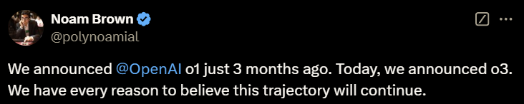
Notes:
https://x.com/polynoamial/status/1870172996650053653

Slide 4
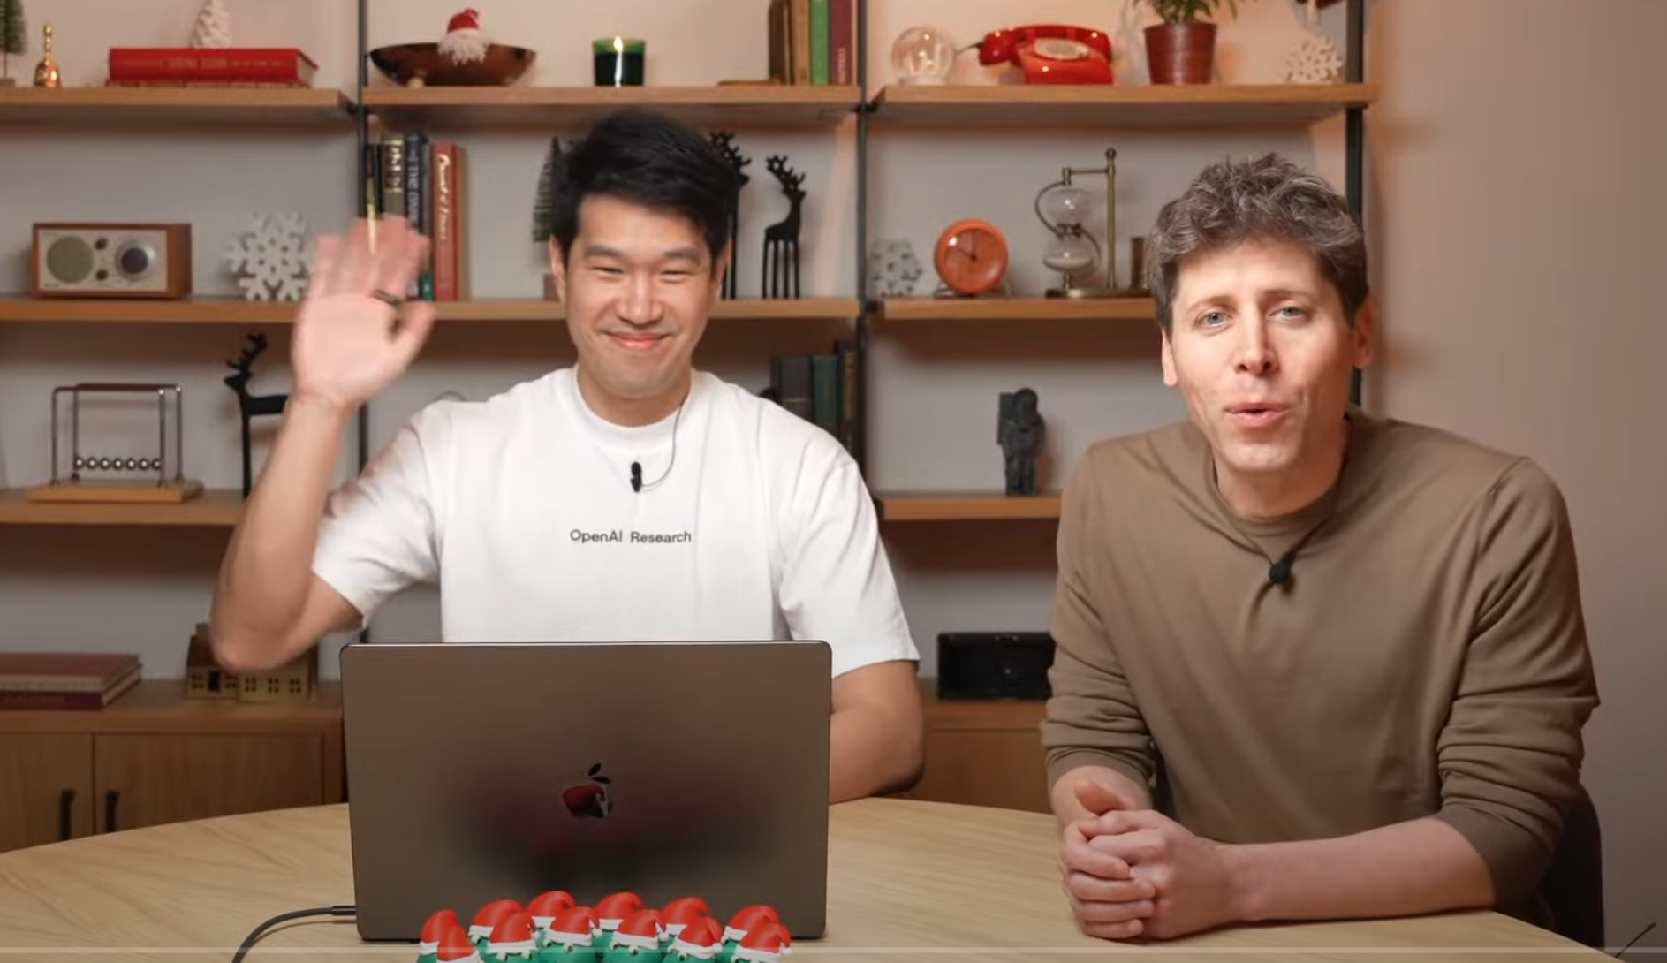
Notes:
https://www.youtube.com/watch?v=SKBG1sqdyIU

Slide 5

Notes:
https://news.virginmediao2.co.uk/about-us/

Slide 6
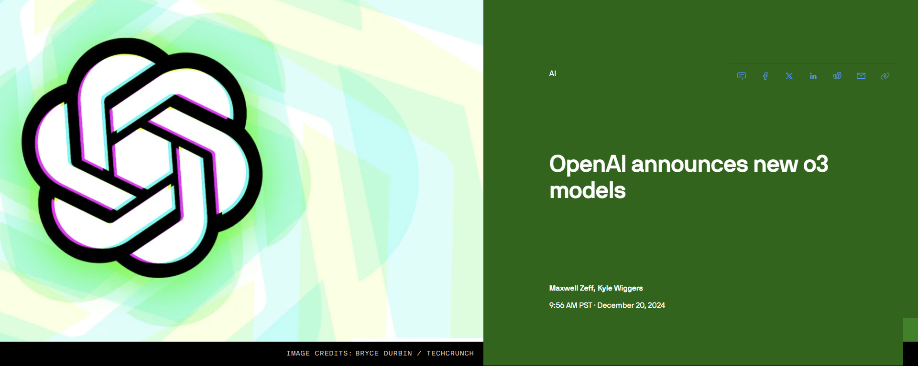
Notes:
https://techcrunch.com/2024/12/20/openai-announces-new-o3-model/

Slide 7
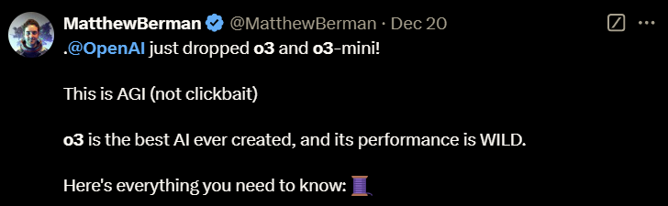
Notes:
https://x.com/MatthewBerman/status/1870189248923742693

Slide 8
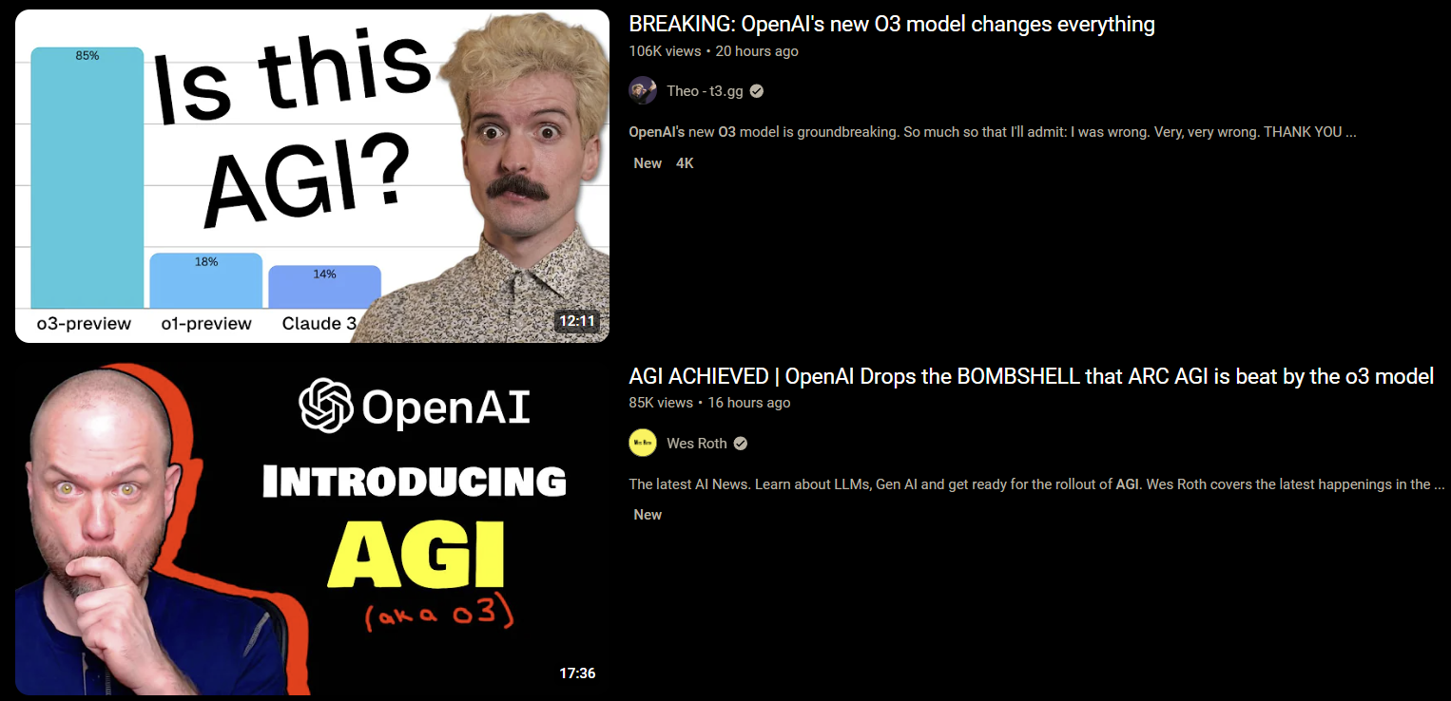
Notes:
https://www.youtube.com/watch?v=Kzf-tL8zyfo&pp=ygUNb3BlbmFpIG8zIGFnaQ%3D%3D
https://www.youtube.com/watch?v=T7Kx1jLspfc&pp=ygUNb3BlbmFpIG8zIGFnaQ%3D%3D

Slide 9
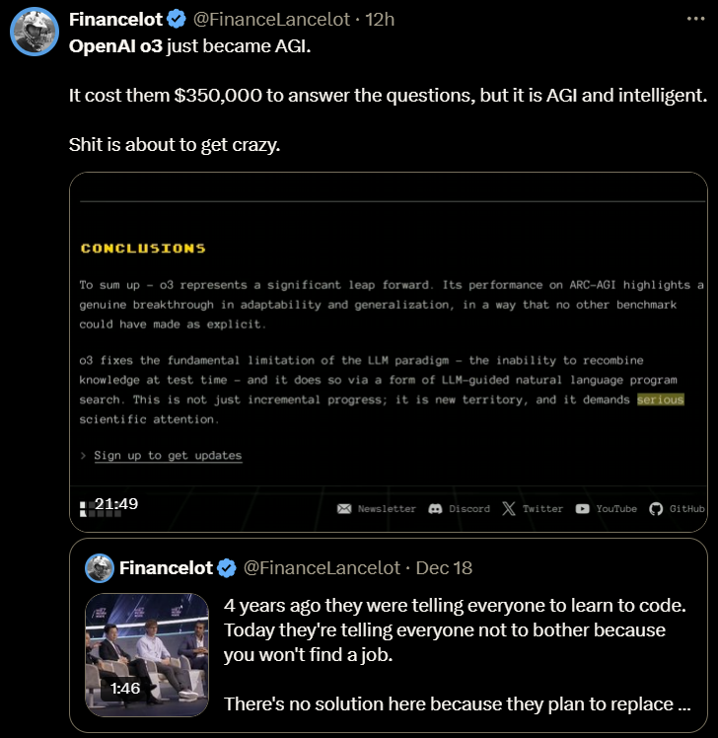
Notes:
https://x.com/FinanceLancelot/status/1870365296671744474

Slide 10
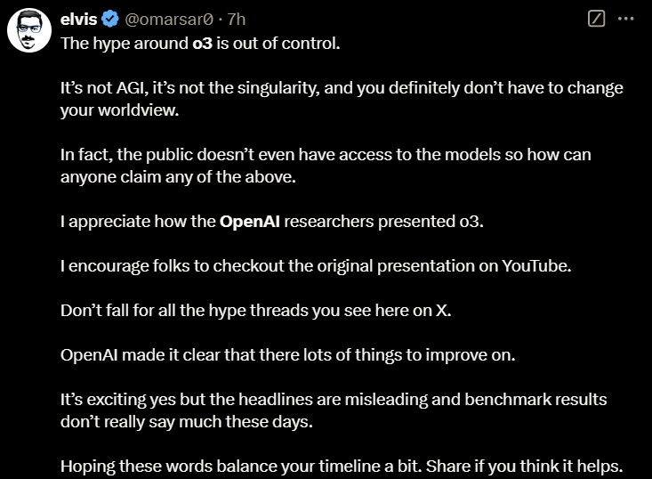
Notes:
https://x.com/omarsar0/status/1870444425375309902

Slide 11
TL:DR
Two Models
o3
o3-mini
Availability
Safety testing today with o3-mini
Only for safety researchers
Must be apply for approval
General availability in Jan or Feb
Is it AGI? NO

Slide 12
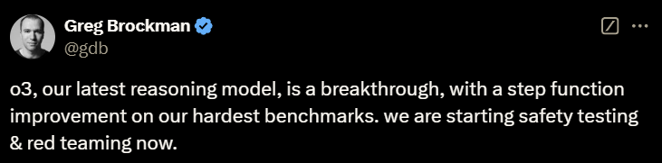
Notes:
https://x.com/gdb/status/1870176891828875658

Slide 13
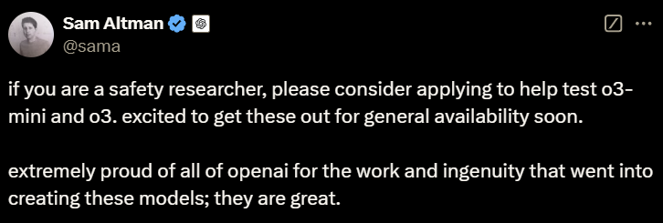
Notes:
https://x.com/sama/status/1870176283851903152

Slide 14
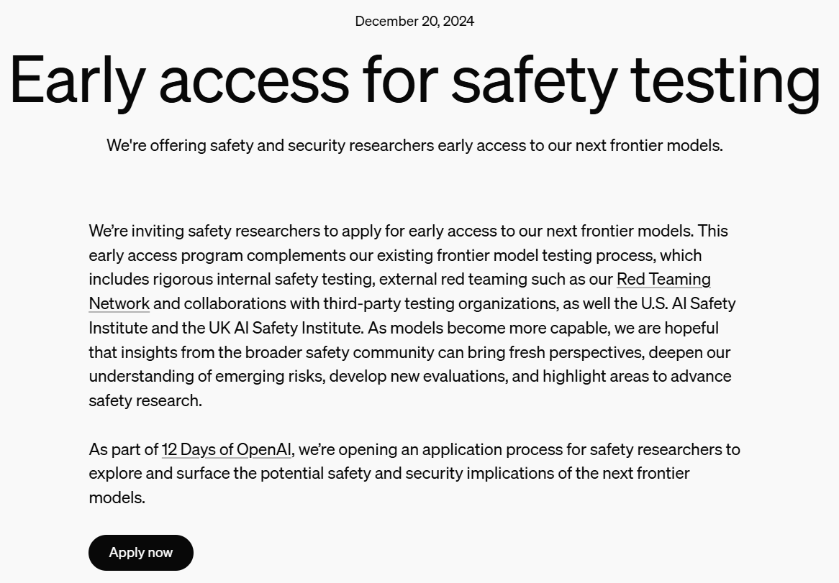
Notes:
https://openai.com/index/early-access-for-safety-testing/

Slide 15
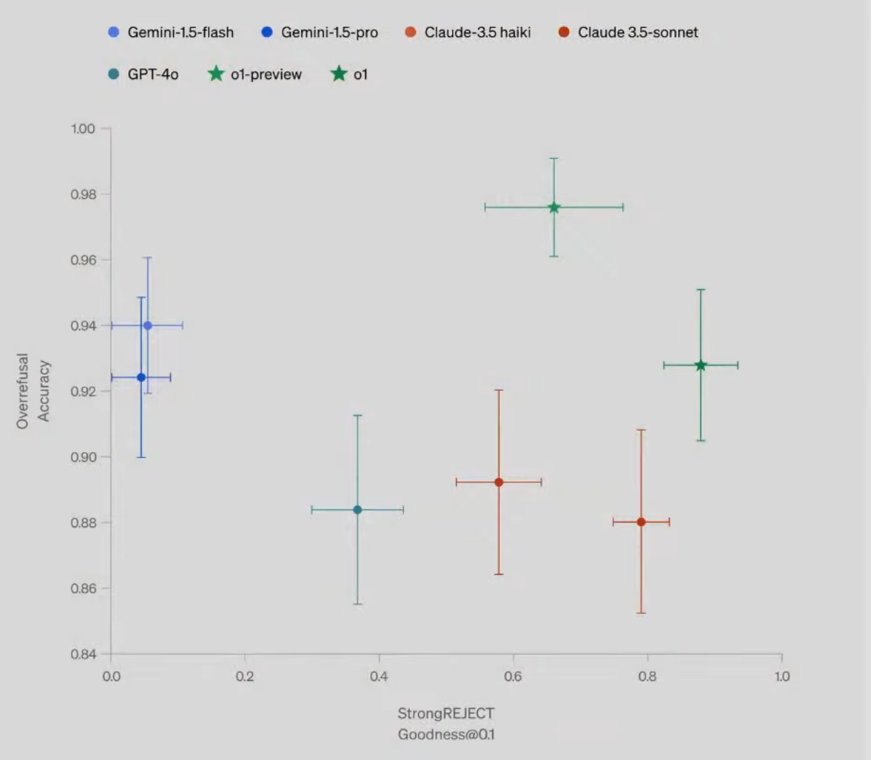
Notes:
This chart is comparing multiple language‐model variants along two axes:
Vertical axis (y‐axis): “Overrefusal Accuracy.”
Higher means the model is more accurate at refusing content when it should refuse.
Horizontal axis (x‐axis): “StrongREJECT Goodness@0.01.”
Higher suggests the model is better at strongly rejecting disallowed content (i.e., less likely to comply with truly problematic requests).
Each colored point (with error bars) is a different model or model variant. The error bars indicate statistical variability or confidence intervals for each metric. Here’s a rough breakdown of what the clusters mean:
Gemini models (blue dots)
They sit on the left‐hand side (low “StrongREJECT Goodness@0.01”) but high on the y‐axis (high Overrefusal Accuracy).
Interpreted: these models do very well at refusing content overall, but they may not be as consistent when strongly rejecting requests at the tightest “goodness” threshold.
GPT‐4o (teal circle)
More in the middle on both axes.
Interpreted: it’s decent at refusing (though not as high as Gemini or O1) and decent on strong rejections—so it’s more balanced but not top in either dimension.
Claude 3.5 (orange/red dots)
Sits roughly mid‐to‐right on the x‐axis and somewhat lower on Overrefusal Accuracy.
Interpreted: it is somewhat better at strong rejections than Gemini but lower on overall refusal accuracy.
O1 and O1-preview (green stars)
Far to the right (excellent “StrongREJECT Goodness”) and also near the top on Overrefusal Accuracy.
Interpreted: these appear to be the best performers overall, with strong refusal accuracy plus strong consistency in how they handle disallowed content at the strict threshold.
In short, the ideal spot on this chart is the top‐right corner (high on both axes), and O1 or O1‐preview are closest to that ideal. Gemini models excel at overall refusal accuracy but don’t quite match that “strong” threshold measure. GPT‐4o and Claude 3.5 variants fall somewhere in between.

Slide 16
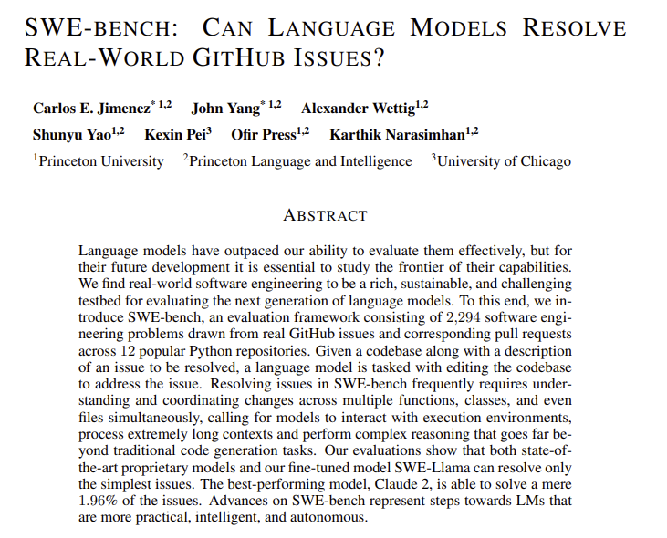
Notes:
https://arxiv.org/pdf/2310.06770
https://www.swebench.com/

Slide 17

Notes:
https://www.youtube.com/@AIPapersPodcastDaily

Slide 18

Notes:
https://shop.reallyeasy.ai/

Slide 19
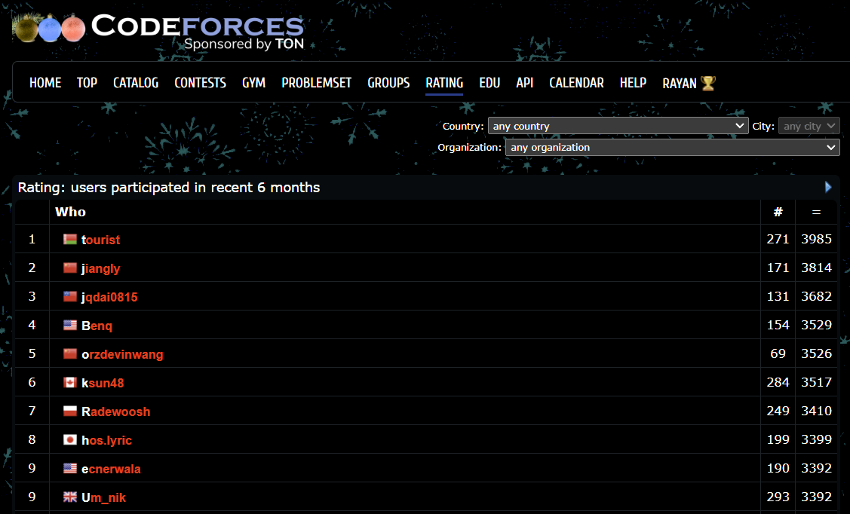
Notes:
https://codeforces.com/ratings

Slide 20
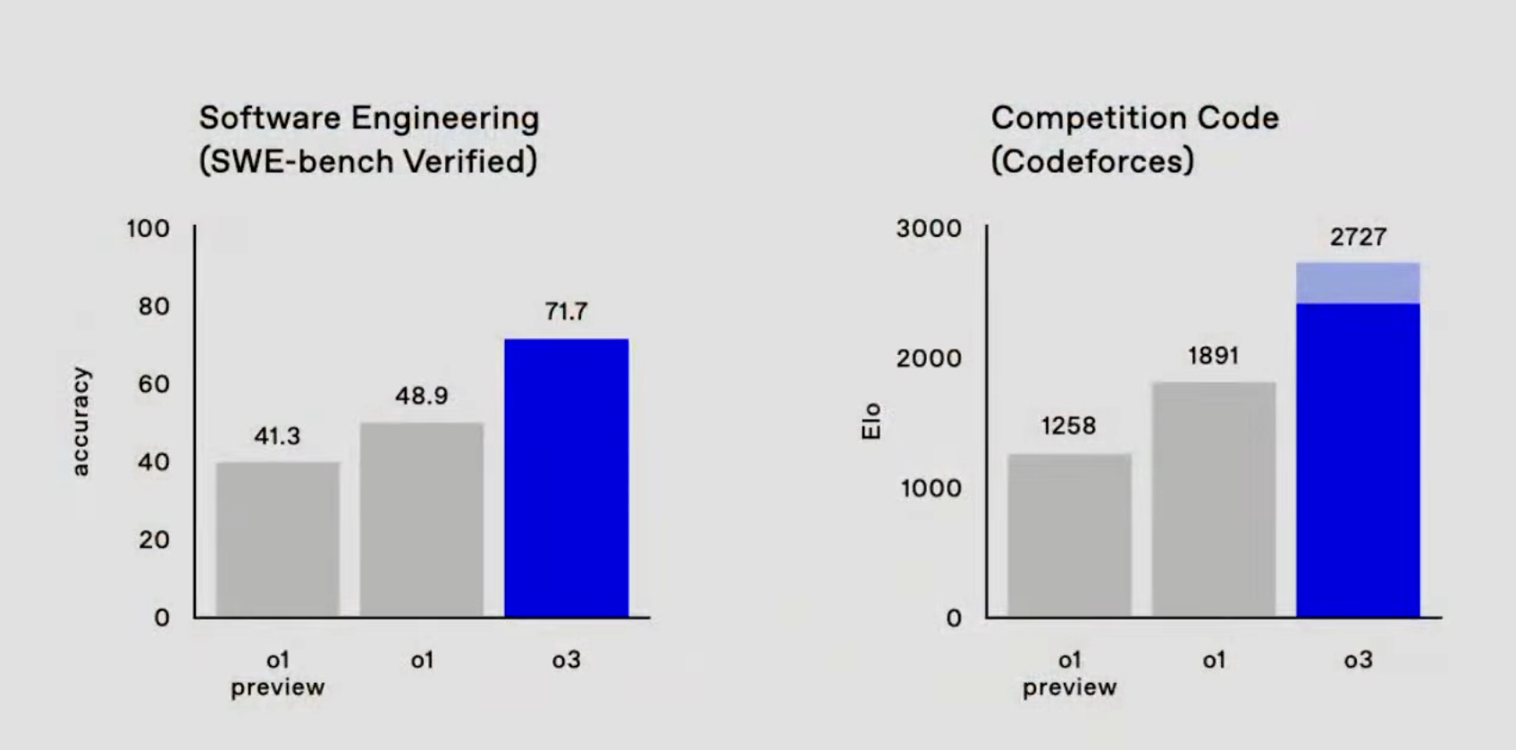

Slide 21
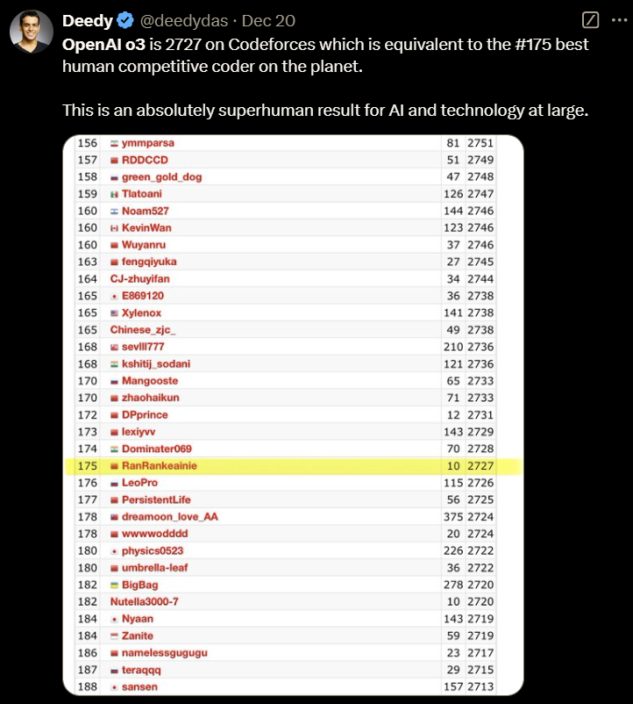
Notes:
https://x.com/deedydas/status/1870175212328608232

Slide 22
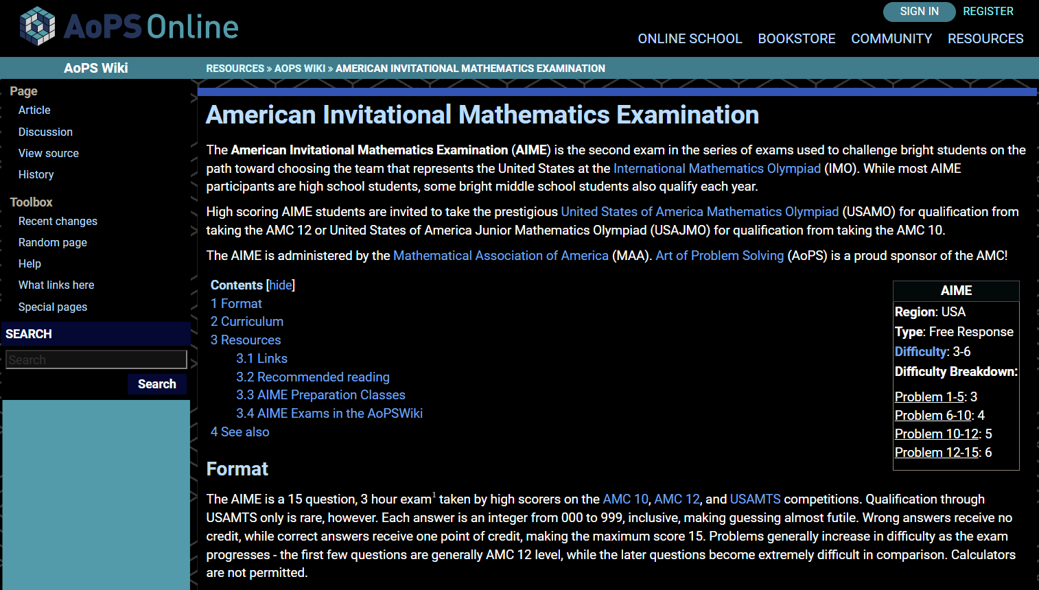
Notes:
https://artofproblemsolving.com/wiki/index.php/American_Invitational_Mathematics_Examination
https://artofproblemsolving.com/wiki/index.php/2024_AIME_I

Slide 23
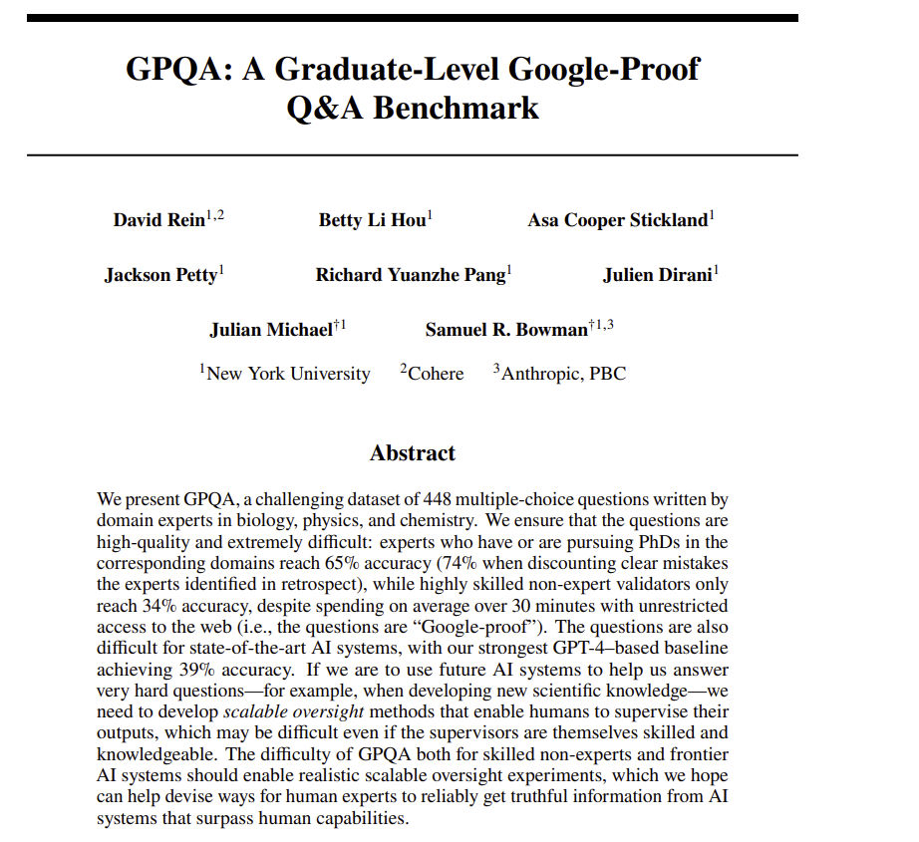
Notes:
https://arxiv.org/pdf/2311.12022
https://github.com/idavidrein/gpqa

Slide 24
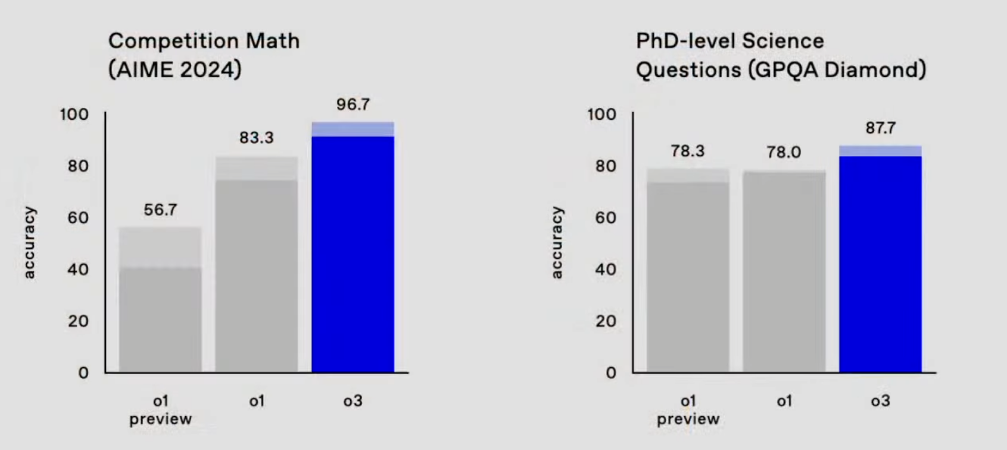

Slide 25
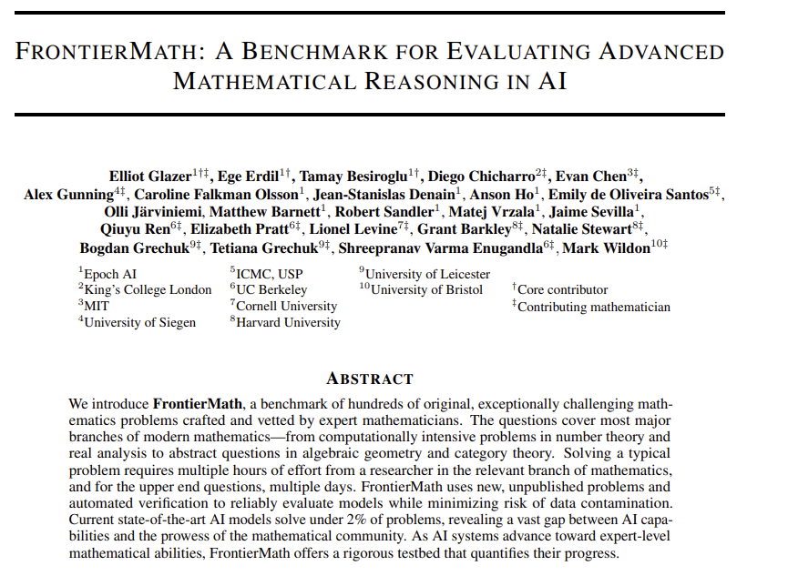
Notes:
https://arxiv.org/pdf/2411.04872
https://epoch.ai/frontiermath/the-benchmark

Slide 26
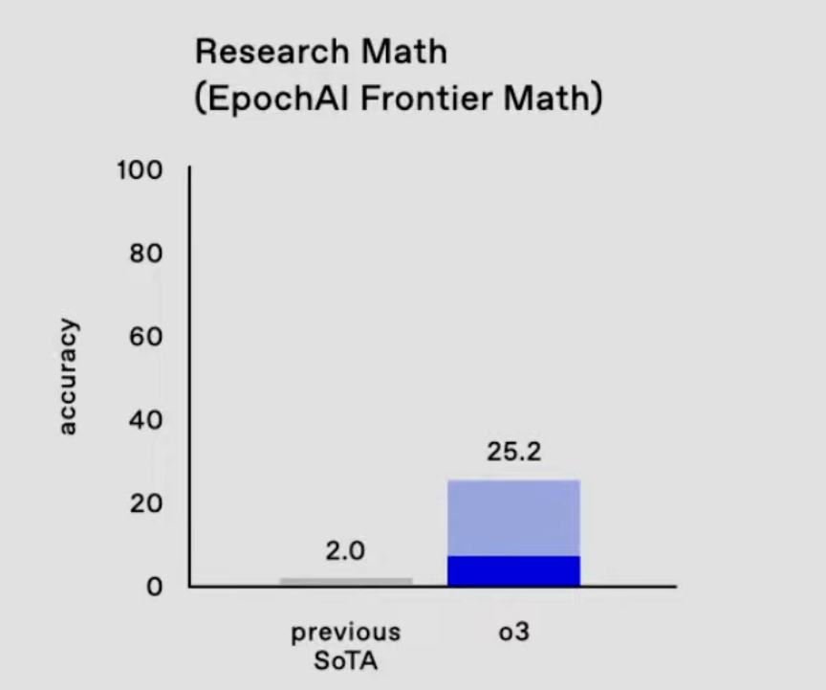

Slide 27
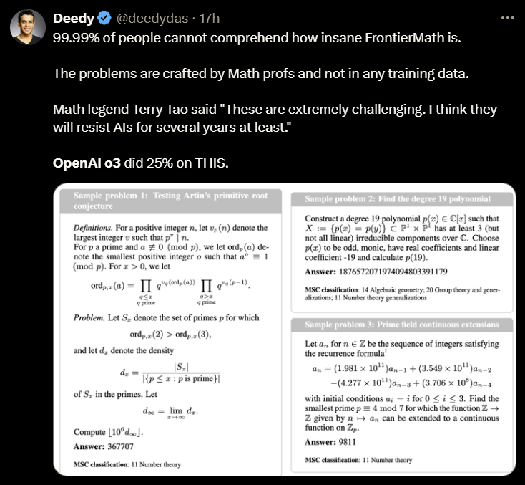
Notes:
https://x.com/deedydas/status/1870286948235128939

Slide 28
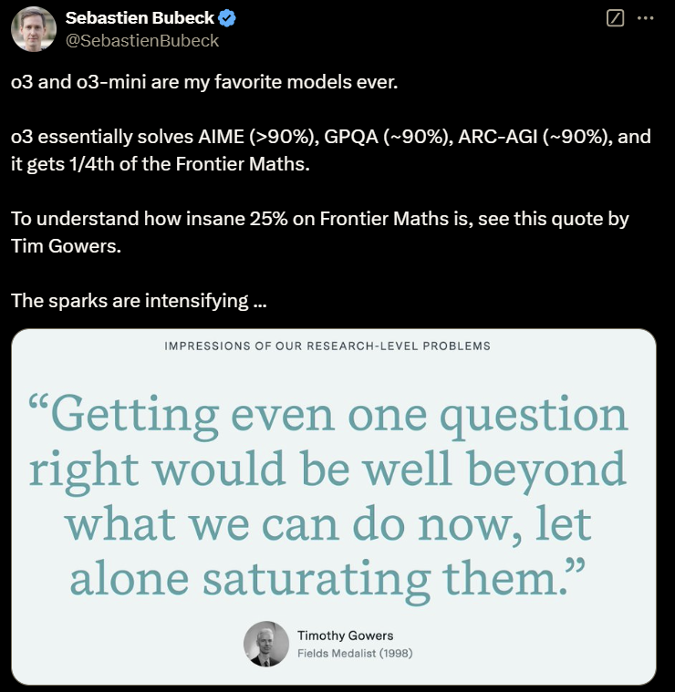
Notes:
https://x.com/SebastienBubeck/status/1870174743351177324

Slide 29

Notes:
https://arcprize.org/

Slide 30
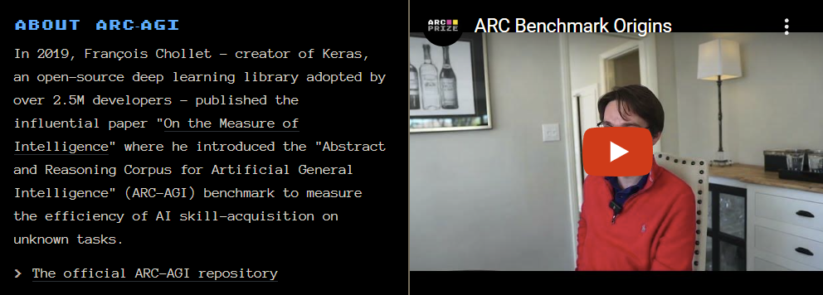
Notes:
https://arcprize.org/arc
https://www.youtube.com/watch?v=2W5D6J8om0c

Slide 31
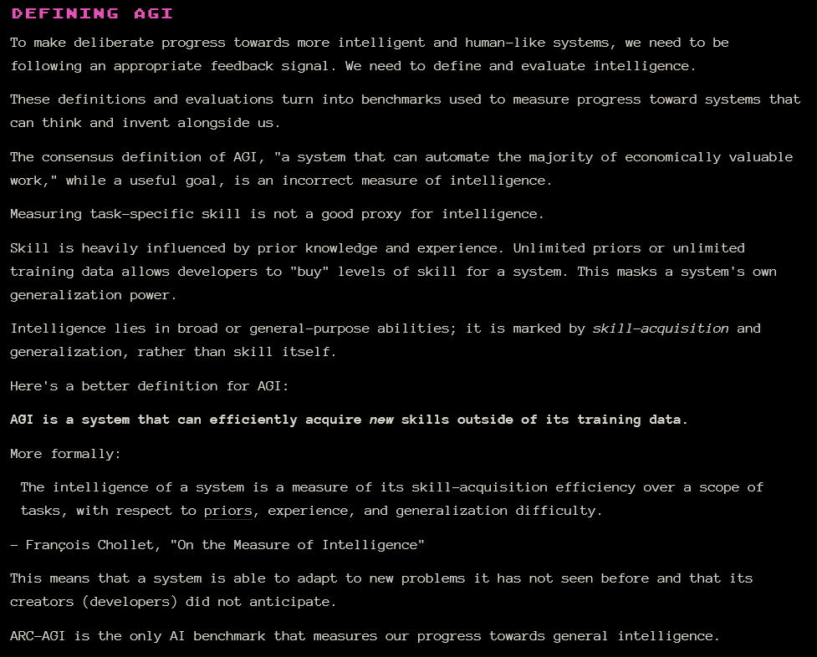
Notes:
https://arcprize.org/arc

Slide 32
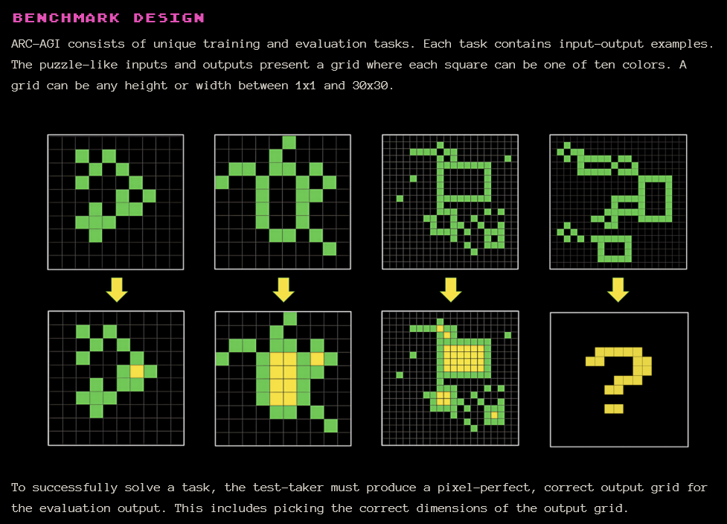
Notes:
https://arcprize.org/arc

Slide 33
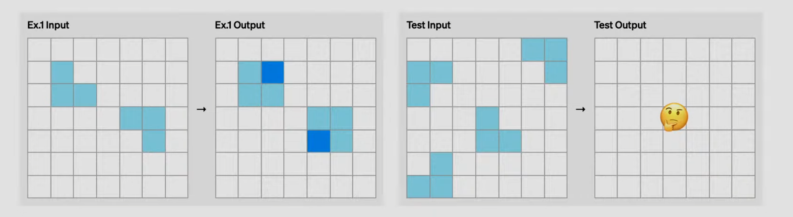

Slide 34
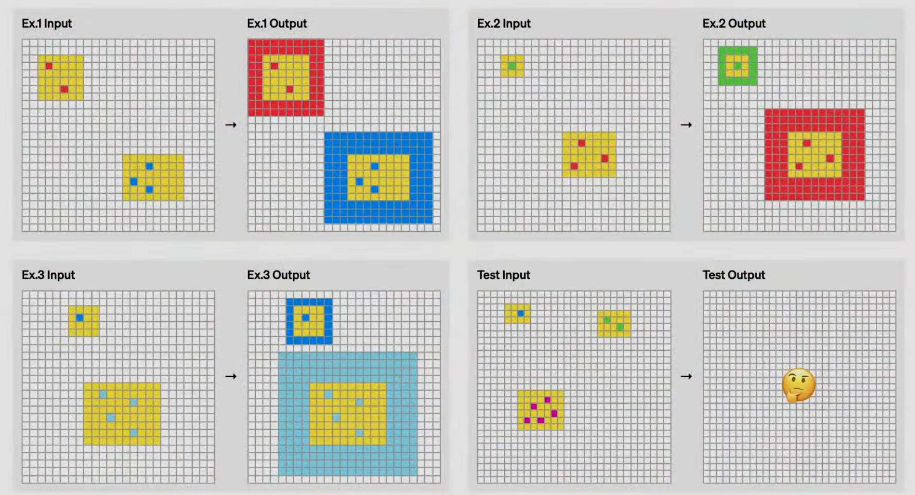

Slide 35
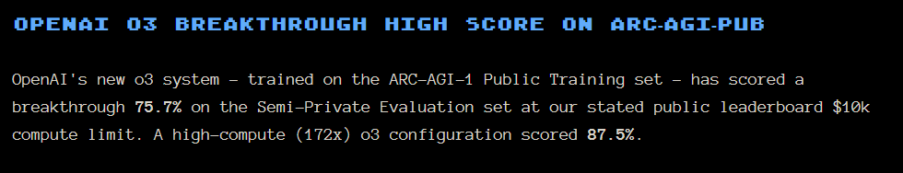
Notes:
https://arcprize.org/blog/oai-o3-pub-breakthrough

Slide 36
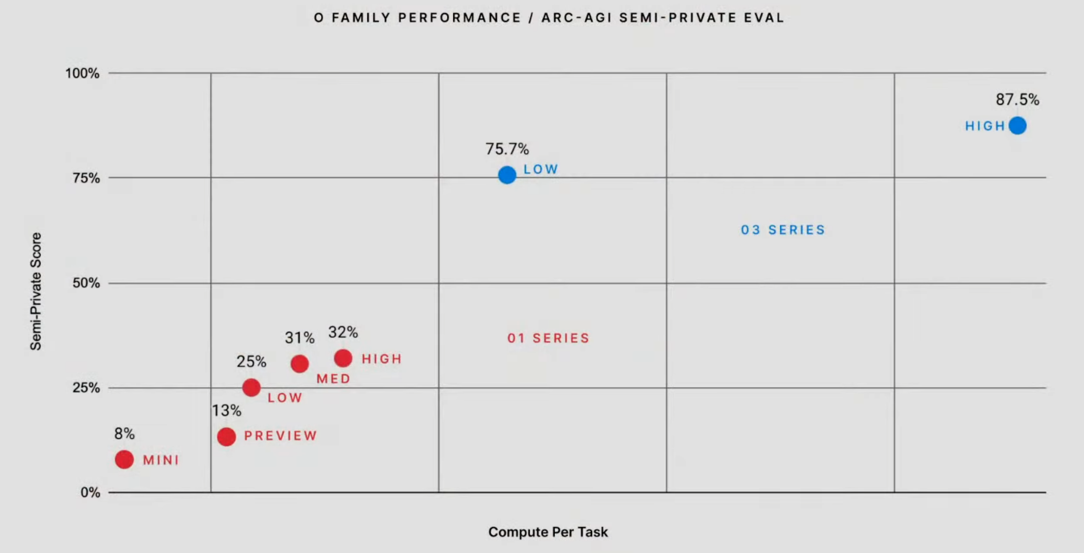
85%
Human Performance

Slide 37
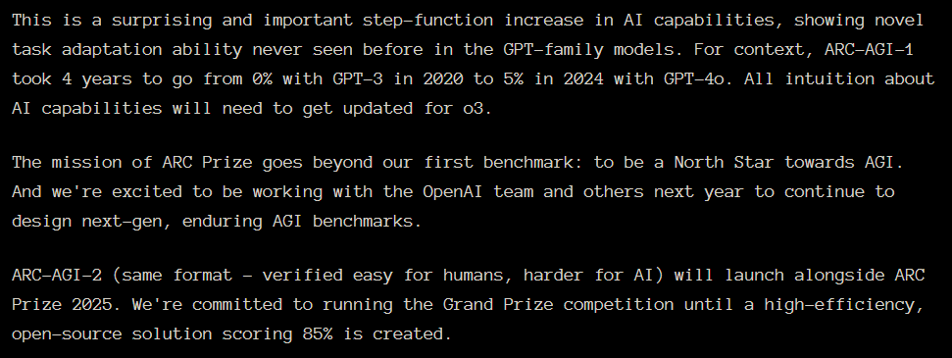
Notes:
https://arcprize.org/blog/oai-o3-pub-breakthrough

Slide 38
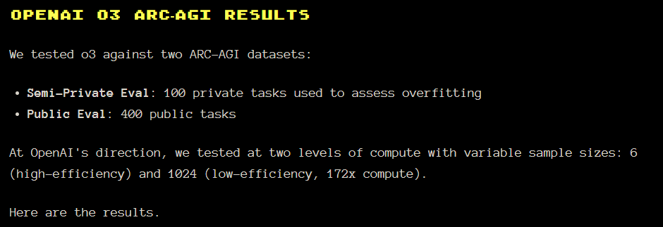
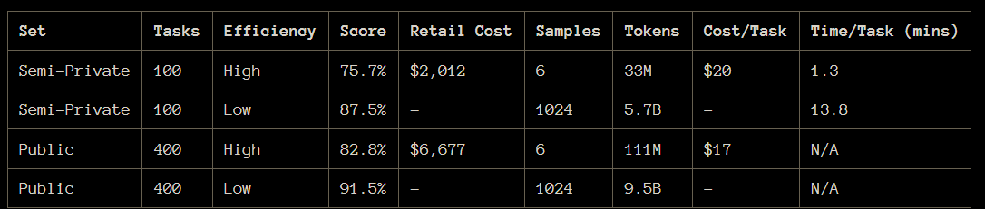
Notes:
https://arcprize.org/blog/oai-o3-pub-breakthrough

Slide 39
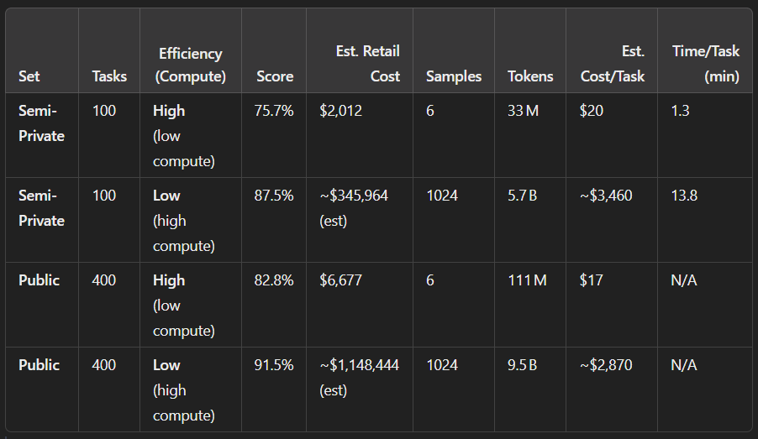

Slide 40
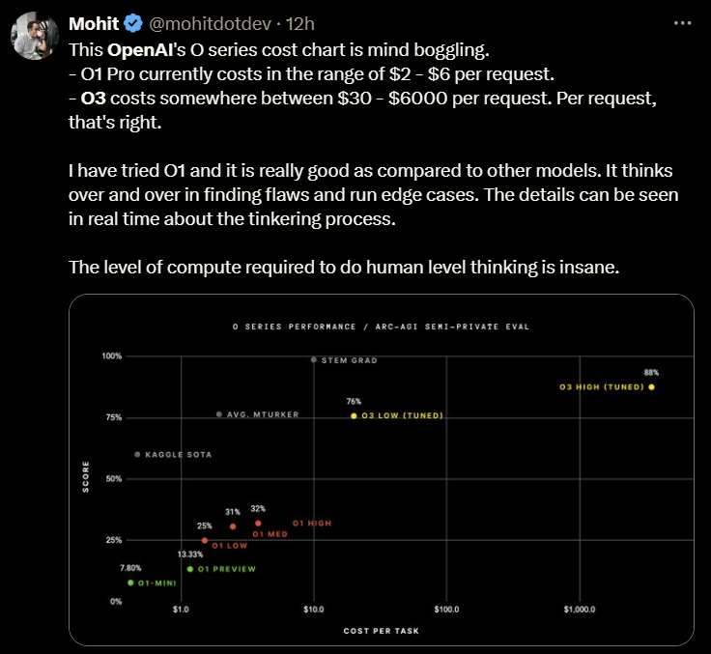
Notes:
https://x.com/mohitdotdev/status/1870376156546973811

Slide 41
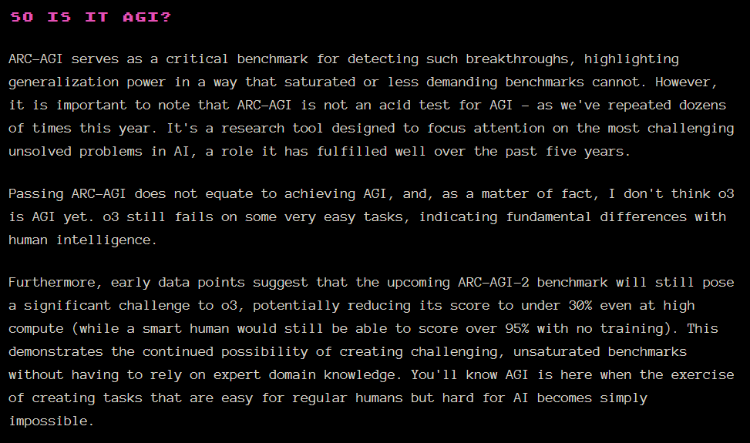
Notes:
https://arcprize.org/blog/oai-o3-pub-breakthrough

Slide 42
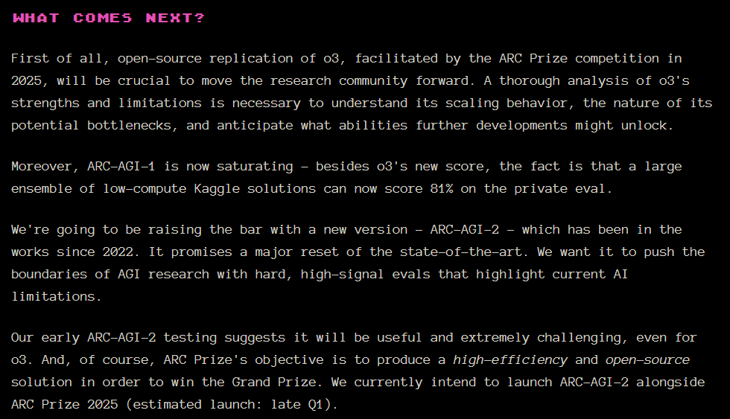
Notes:
https://arcprize.org/blog/oai-o3-pub-breakthrough

Slide 43
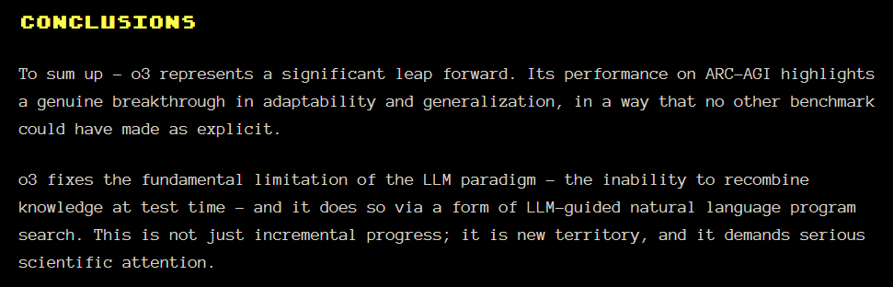
Notes:
https://arcprize.org/blog/oai-o3-pub-breakthrough

Slide 44
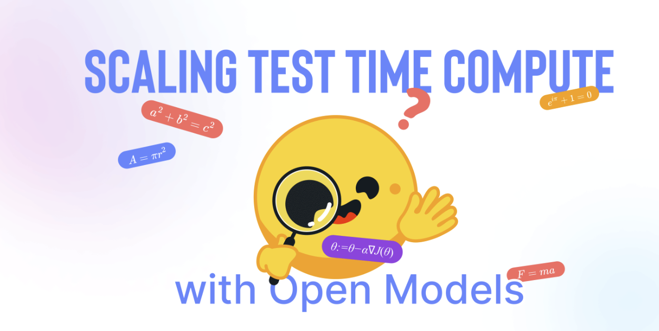
Notes:
https://huggingface.co/spaces/HuggingFaceH4/blogpost-scaling-test-time-compute

Slide 45
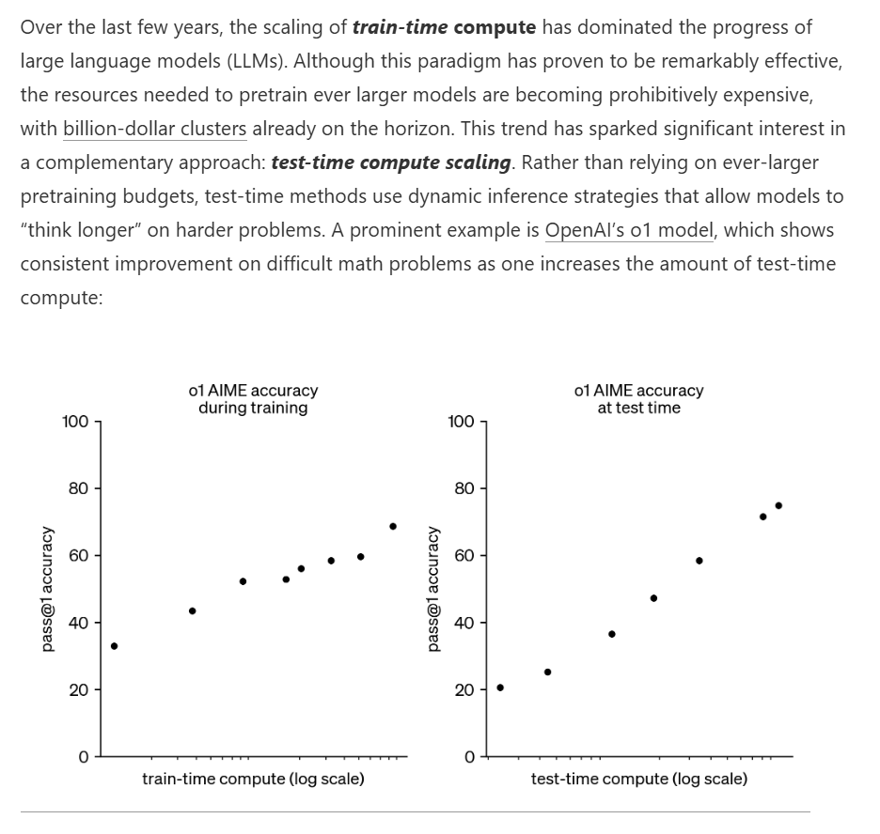
Notes:
https://huggingface.co/spaces/HuggingFaceH4/blogpost-scaling-test-time-compute

Slide 46

Notes:
https://www.youtube.com/@ainewsfresh

Slide 47
o3-mini
Different Reasoning Efforts Available (thinking time)
Low
Medium
High

Slide 48
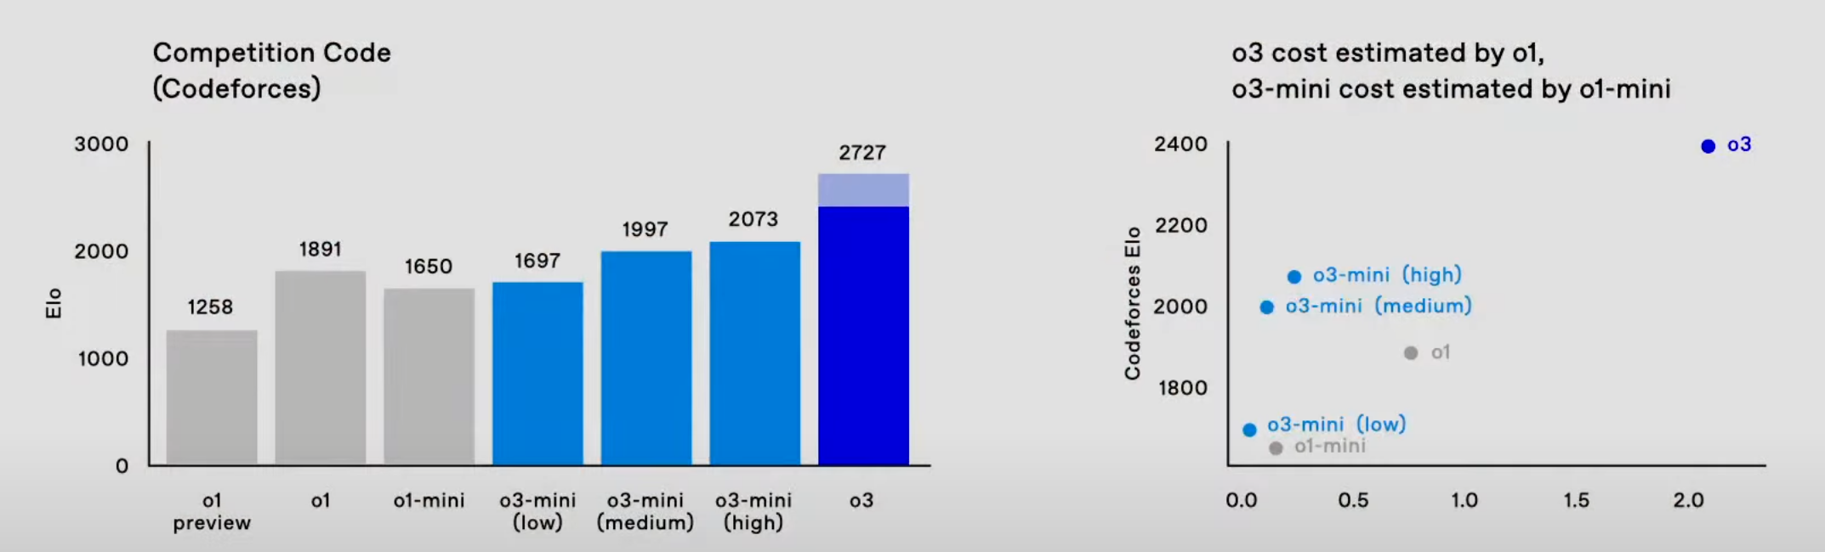

Slide 49
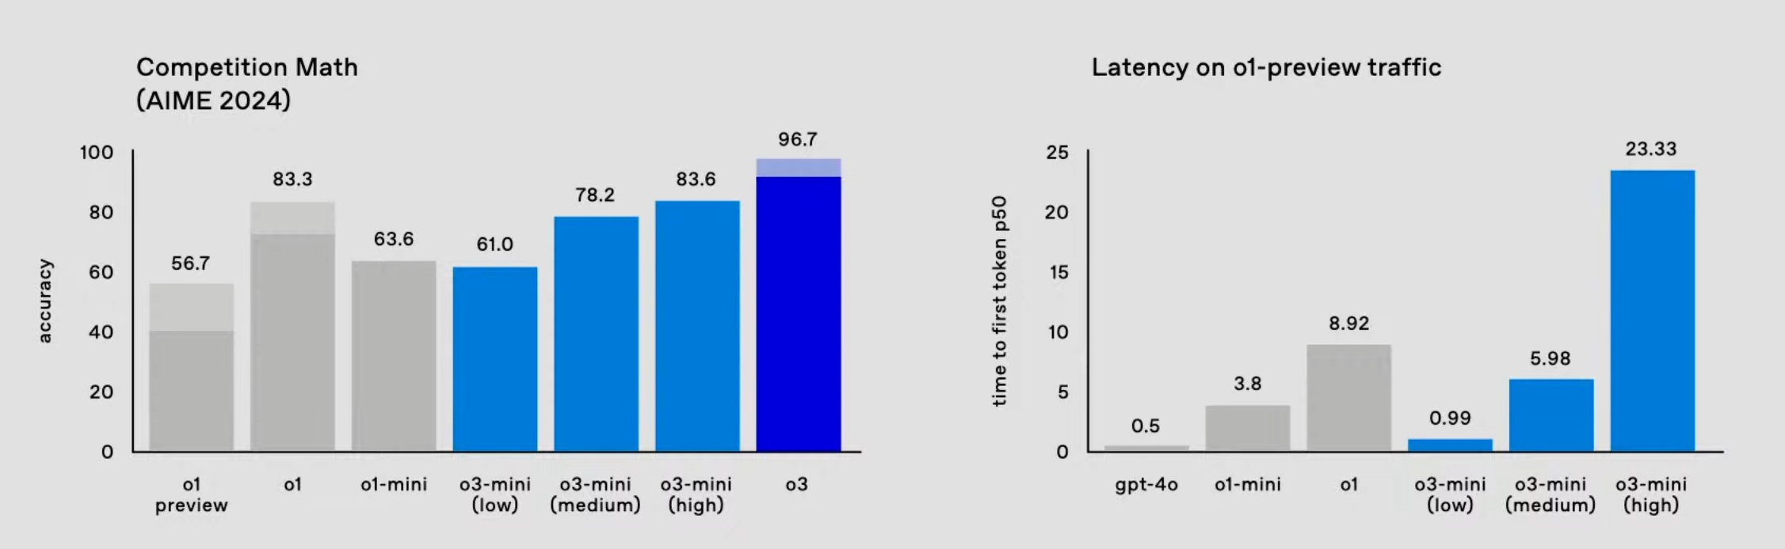

Slide 50
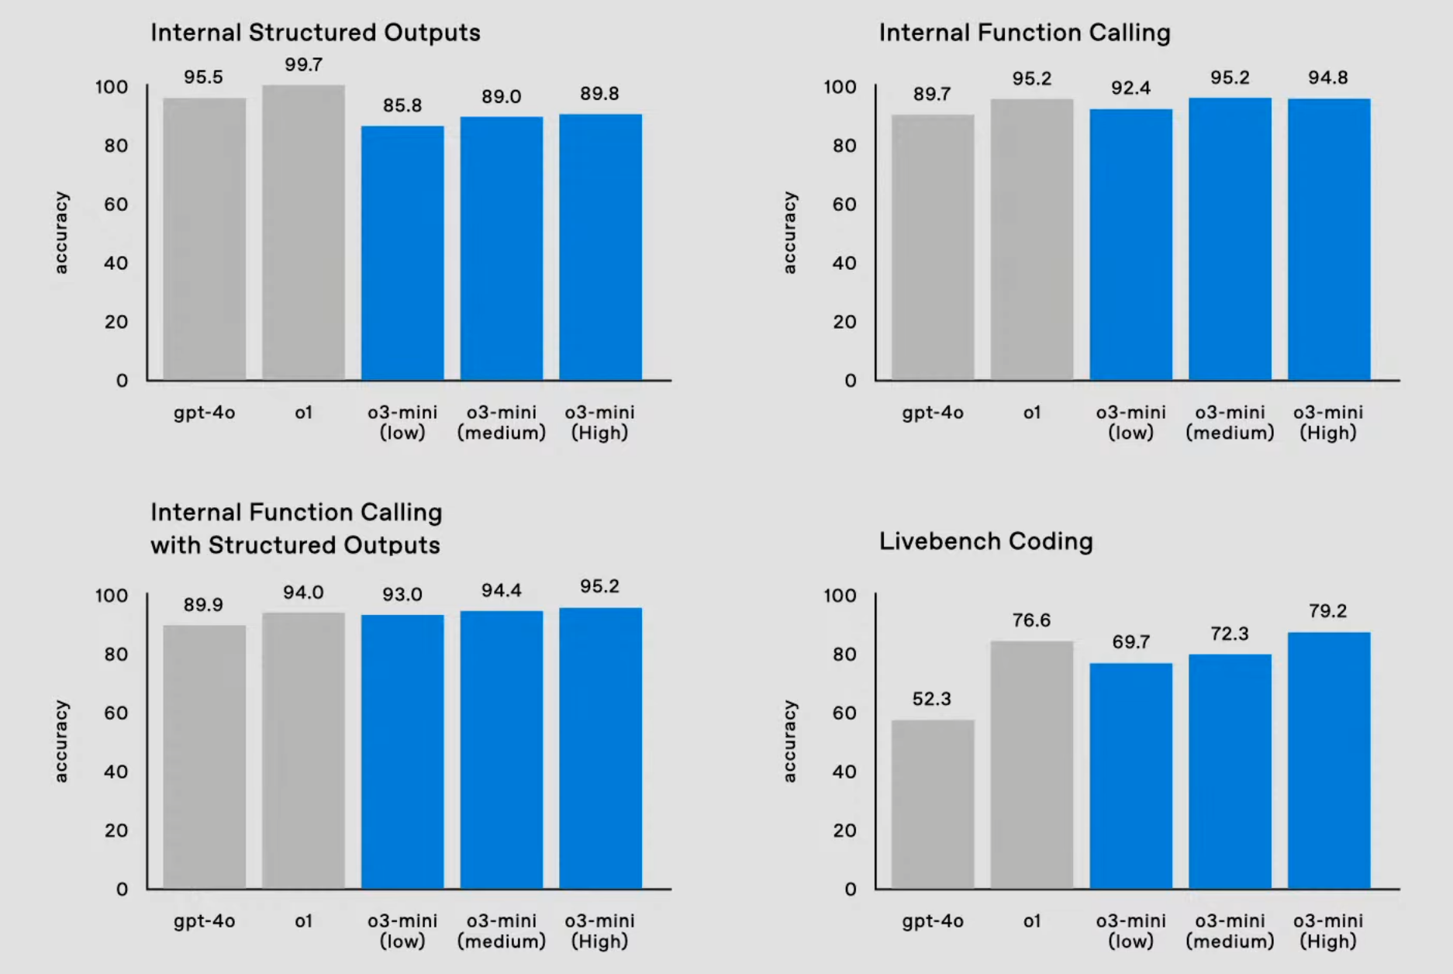

Slide 51
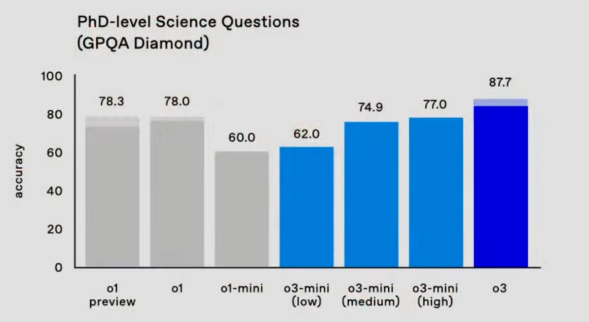

Slide 52
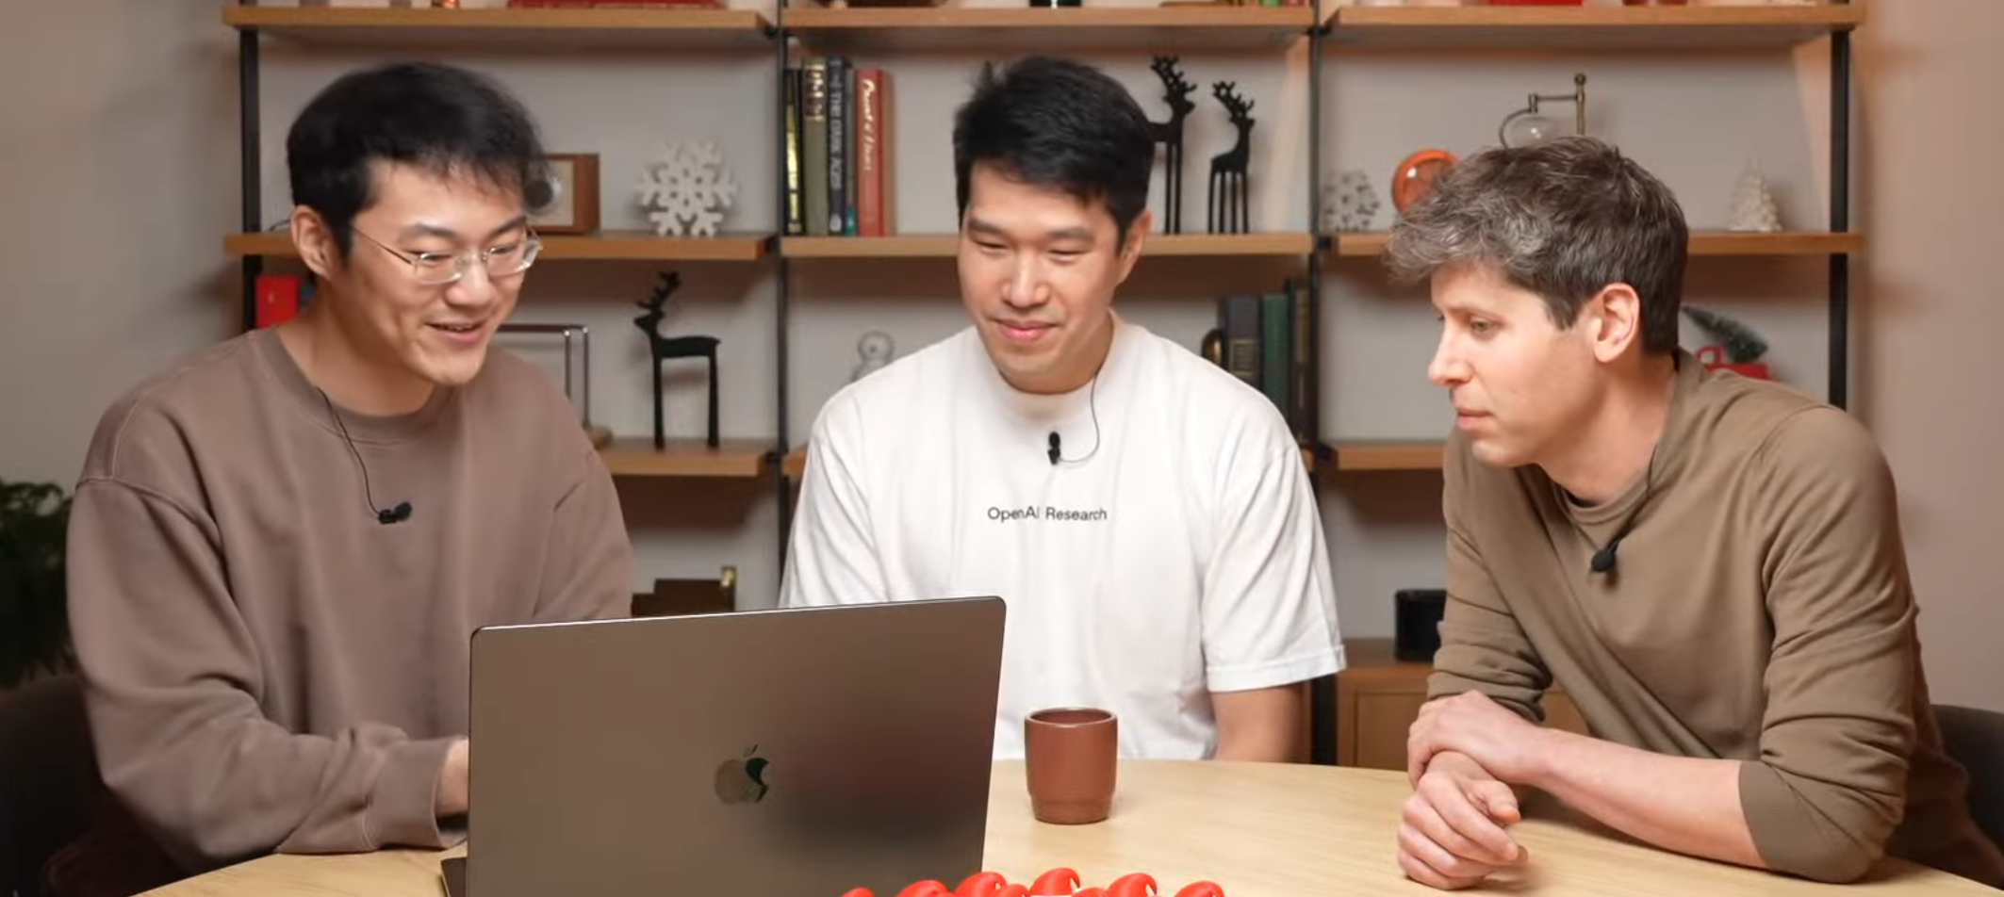
Live Demo of o3-mini
Notes:
https://www.youtube.com/live/SKBG1sqdyIU?si=YunaDEtoN2YBgA52&t=767

Slide 53
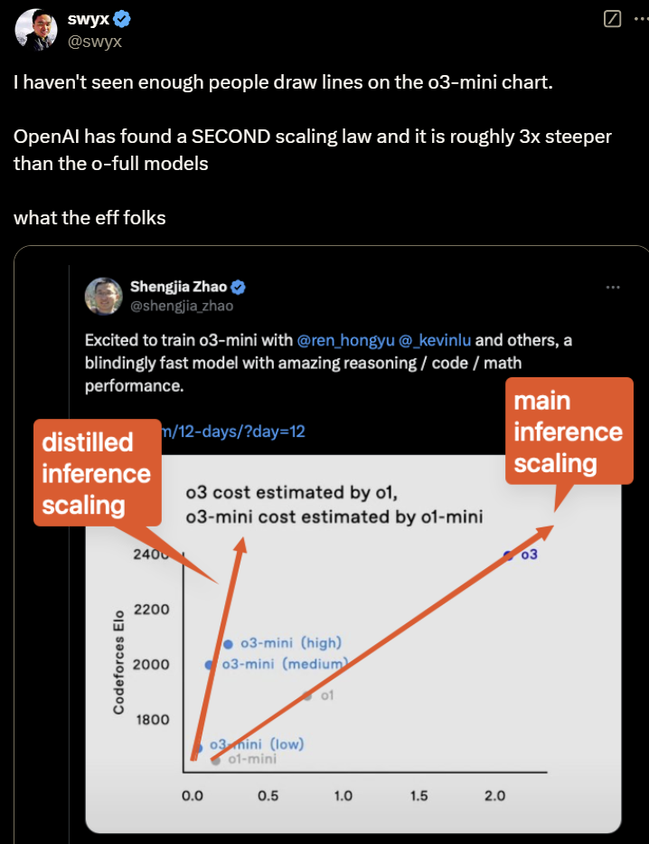
Notes:
https://x.com/swyx/status/1870285293078949972

Slide 54
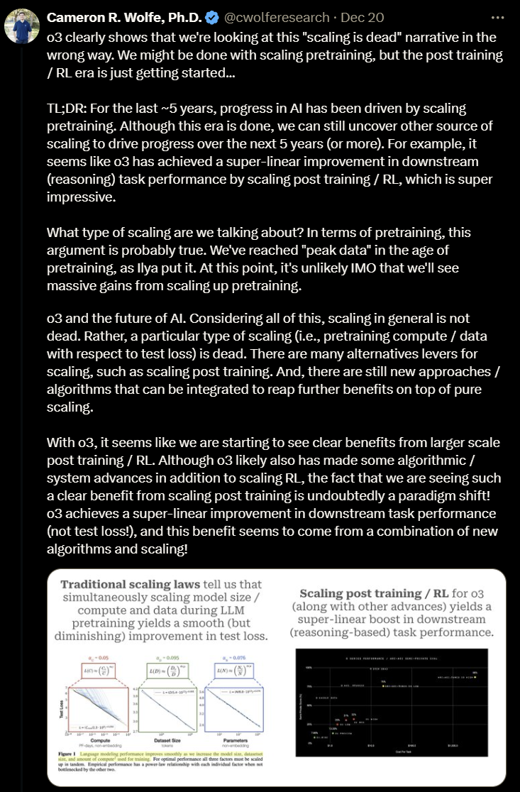
Notes:
https://x.com/cwolferesearch/status/1870189945106641364

Slide 55
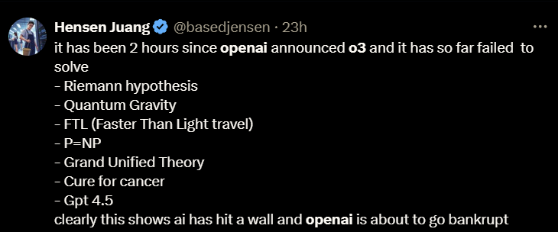
Notes:
https://x.com/basedjensen/status/1870203814323859633

